Slide 1
AUGMENTED LAGRANGIAN METHOD
Giacomo Bacchetta
Edoardo Cesaroni
Complex Systems Optimization 2021/2022

Slide 2
AUGMENTED LAGRANGIAN METHOD SOME THEORETICAL BACKGROUND...
It is also known as multiplier method;
It is used for the constrained optimization;
It is applied by modifying the Lagrangian function with penalty terms and using an unconstrained optimization method.
Given a general constrained optimization problem (with inequality and equality constraints), the augmented Lagrangian function is :
$$L_{A}\left(x, λ, μ;ε\right)=f\left(x\right)+ μ^{T}h\left(x\right)+ \frac{1}{ε} |\left|h\left(x\right)\right||^{2 }+λ^{T}\max\left\{g\left(x\right), −\frac{ε}{2}λ\right\}+ \frac{1 }{ε} ||\max\left\{g\left(x\right), −\frac{ε}{2} λ\right\}{||}^{2}$$
First term of quadratic penalty
Second term of quadratic penalty

Slide 3

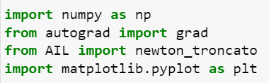
... AND PRACTICAL BACKGROUND
In the first cell of the IPYNB file we imported the libraries and other .py files useful for the implementation of the algorithm.
Numpy, it allows the use of simple mathematical functions;
Autograd, used to calculate the gradient of functions;
AIL.py, which contains the unconstrained optimization method;
MatPlotLib, used to represent the computational results.

Slide 4

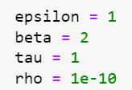
THE ALGORITHM
aug_lag is the function that contains the core of the augmented Lagrangian method.
The input arguments of the aug_lag function are:
The objective function f;
The list of inequality constraints g;
The list of equality constraints h;
The starting point x₀.
Then we set the initial values of the parameters.

Slide 5
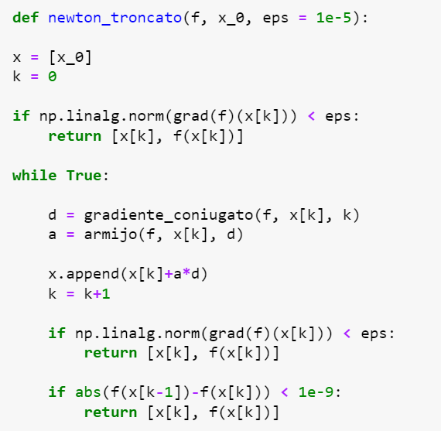
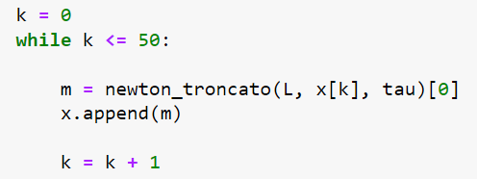
CORE
In each iteration we solved an unconstrained optimization problem where the objective function was the augmented Lagrangian function.
We chose the truncated Newton method as unconstrained optimization one.

Slide 6


EXIT CONDITIONS
Then we checked if the point found by the truncated Newton method meets, with his KKT multipliers, the exit conditions.
The exit conditions applied in this algorithm are:
Verification of the condition about the gradient norm of the augmented Lagrangian function;
Verification of the Karush-Kuhn-Tucker conditions .

Slide 7
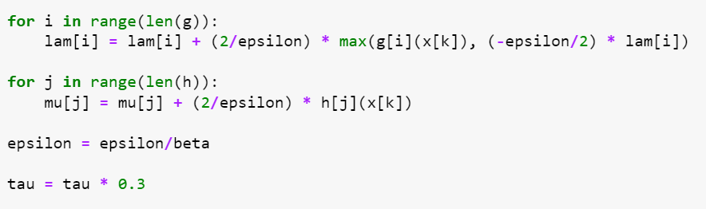
PARAMETERS UPDATE
If the exit conditions are not satisfied the algorithm proceeds with the update of the parameters.
The new parameters are then used in the next iteration of the method.

Slide 8
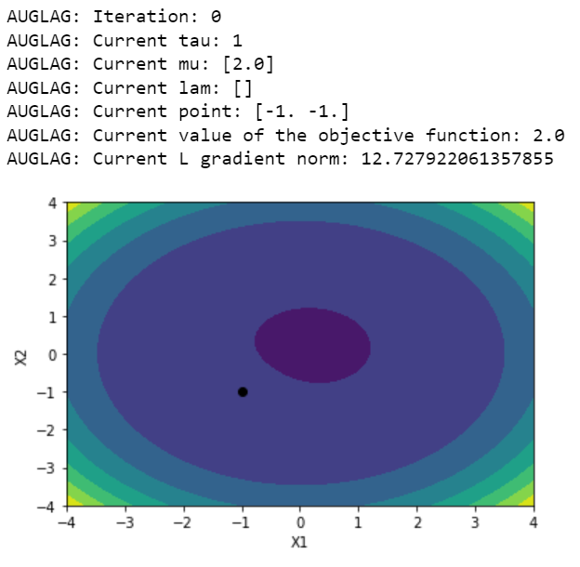
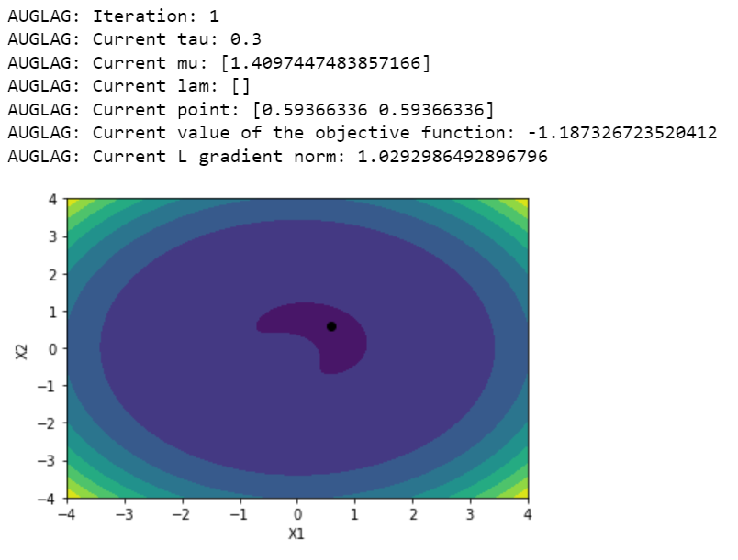
COMPUTATIONAL RESULTS
Problem 1

Slide 9
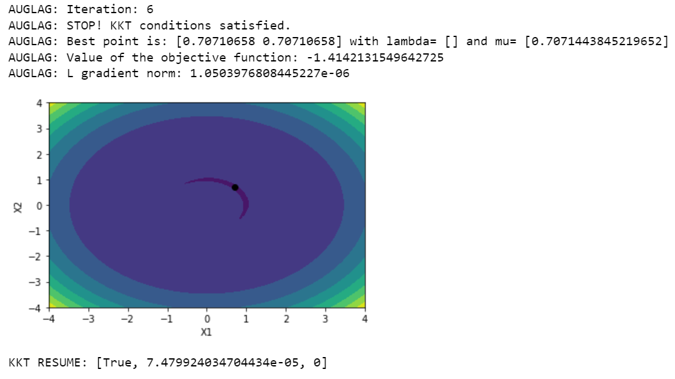
Problem 1
On the left, the final output of the algorithm.
These are the level curves of the augmented Lagrangian function.
At each iteration the graph varies because of the update of the parameters.

Slide 10
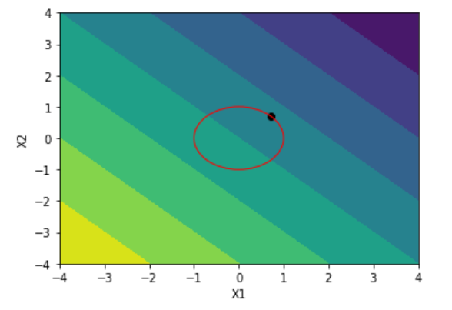
Problem 1
On the left there is the graph of the level curves of the objective function f.
In red is drawn the equality constraint.
In black is drawn the optimum point generated by the augmented Lagrangian method.

Slide 11
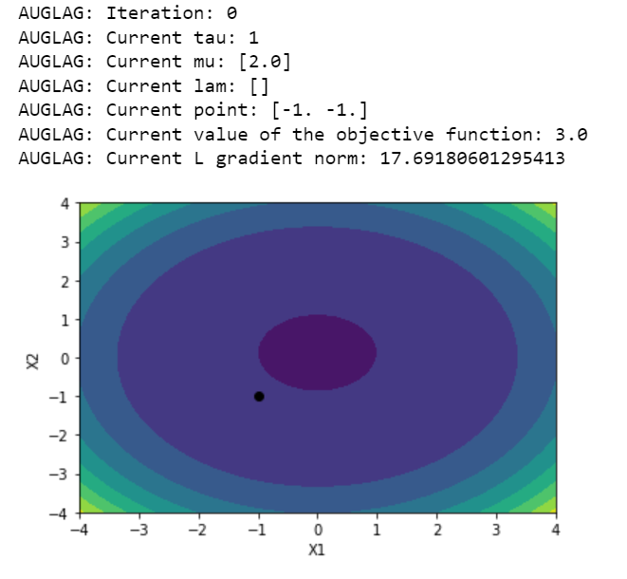
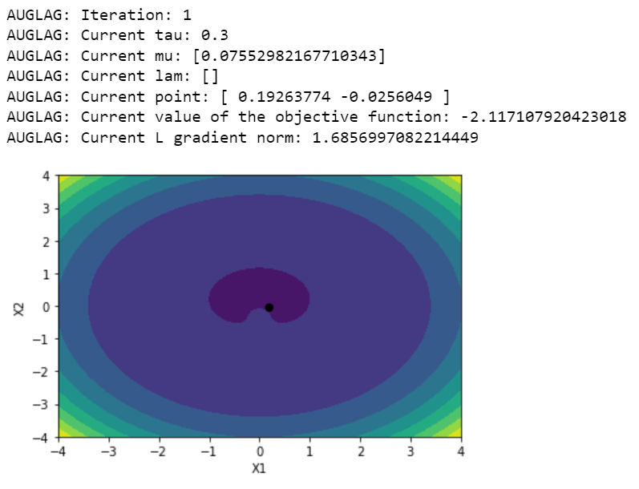
Maratos’ Problem

Slide 12
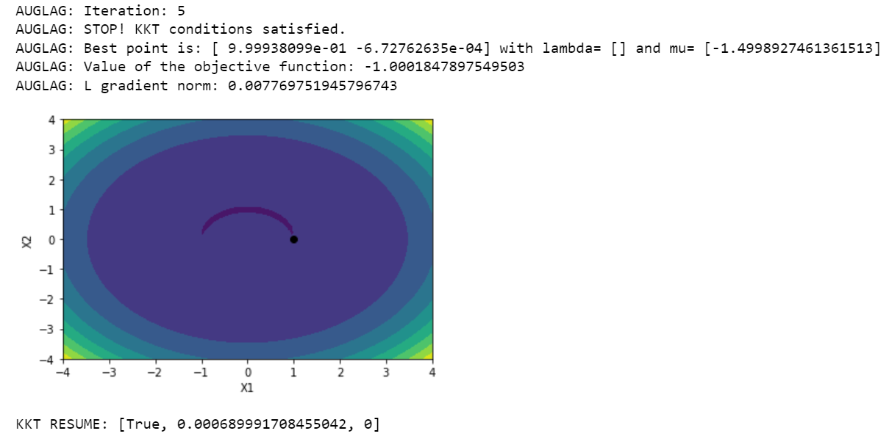
Maratos’ Problem
It is notable that there is a 'crush’ of the level curves of the augmented Lagrangian function because of the parameters update in each iteration.

Slide 13
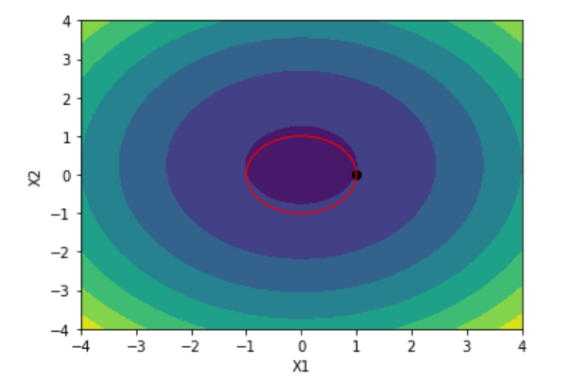
Maratos’ Problem
Note that the level curves of the objective function f change compared to Problem 1.
However, the equality constraint is the same of the previous problem.

Slide 14
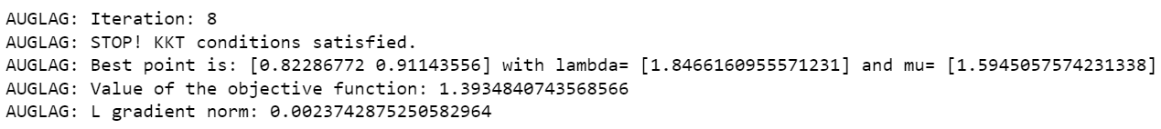
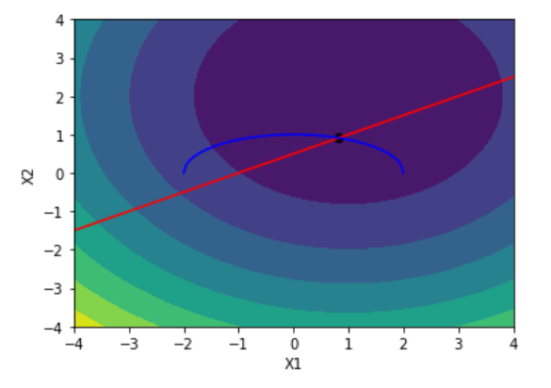
Problem HS 14
Unlike the previous two problems, in this case there is both an inequality constraint (in blue) and an equality constraint (in red).

